Slide 1
Pulse Programmer Documentation
03/15/2026

Slide 2
Specifications
System Clock: 125 MHz
8 ns period
LUT requires 3.5 ns
250 MHz does not meet timing requirement
Pulse Programmer Outputs: 8
Memory Size: 12-bit (4096 addresses)

Slide 3
Pulse Programmer Instructions
OP NAME | OP CODE (BIN) | OP CODE (INT) | DATA | DELAY | DESCRIPTION
NO OP | 0b0000 | 0 | NA | NA | NO OPERATION
DELAY | 0b0001 | 1 | NA | 0 to 2³² - 1 | DELAY FOR DELAY*CLOCK PERIOD NS
LONG DELAY | 0b0010 | 2 | 0 TO 2²⁰ – 1 | 0 to 2³² - 1 | DELAY FOR DATA*DELAY* CLOCK PERIOD NS
JUMP | 0b0011 | 3 | BRAM ADDRESS | NA | JUMP TO ADDRESS
WAIT | 0b1000 | 8 | NA | NA | WAIT FOR TRIGGER INPUT

Slide 4
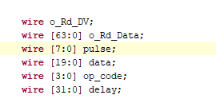

Instructions
pulse | data | op code | delay
8-bit 20-bit 4-bit 32-bit
[63:56] [55:36] [35:32] [31:0]

Slide 5


UART Commands
Currently 10 bytes must be transmitted at a time. Should add timeout
4-bit (16) UART commands are possible
0 = Read from RAM (Not Implemented)
1 = Write to RAM
2 = Start
3 = Stop
4 = ???
Todo
Add software trigger command
External Clock?

Slide 6

Clock
125 MHz clock
8 ns pulse programmer time resolution
Minimum delay/pulse = 8 ns (1 clock cycles)
TESTING REQUIRED
Current Baud Rate: 115200
Maximum Baudrate (6,000,000) needs testing

Slide 7
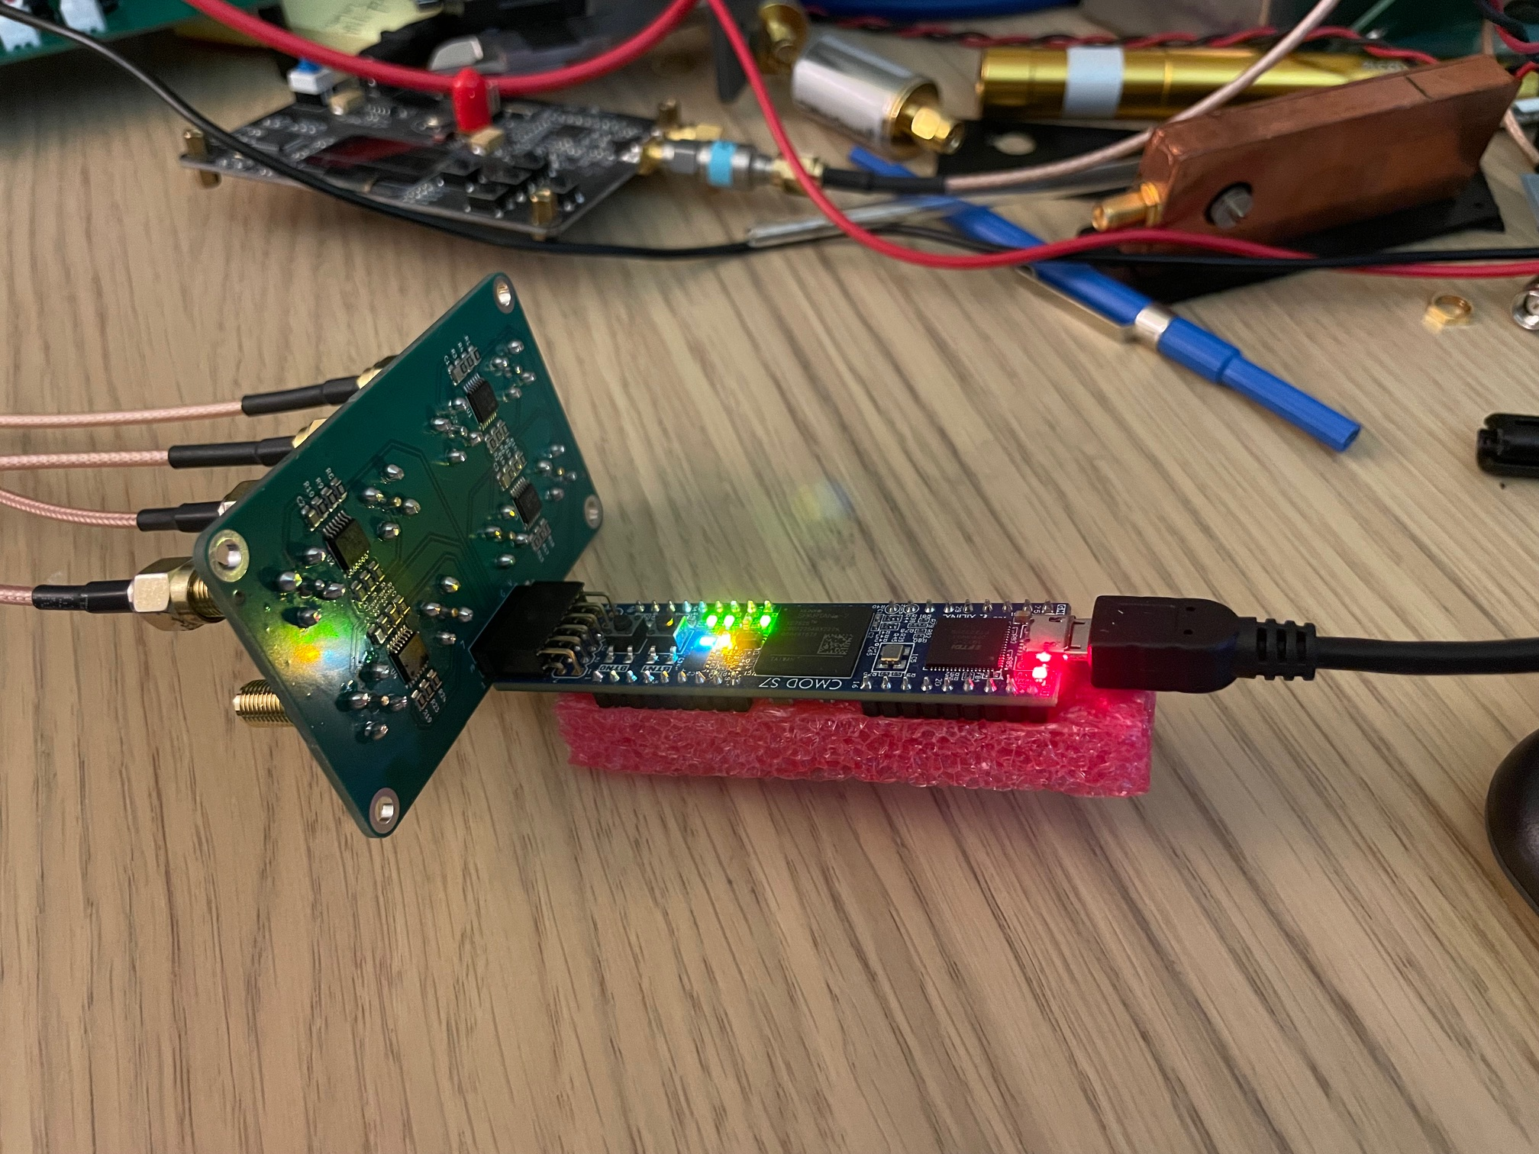
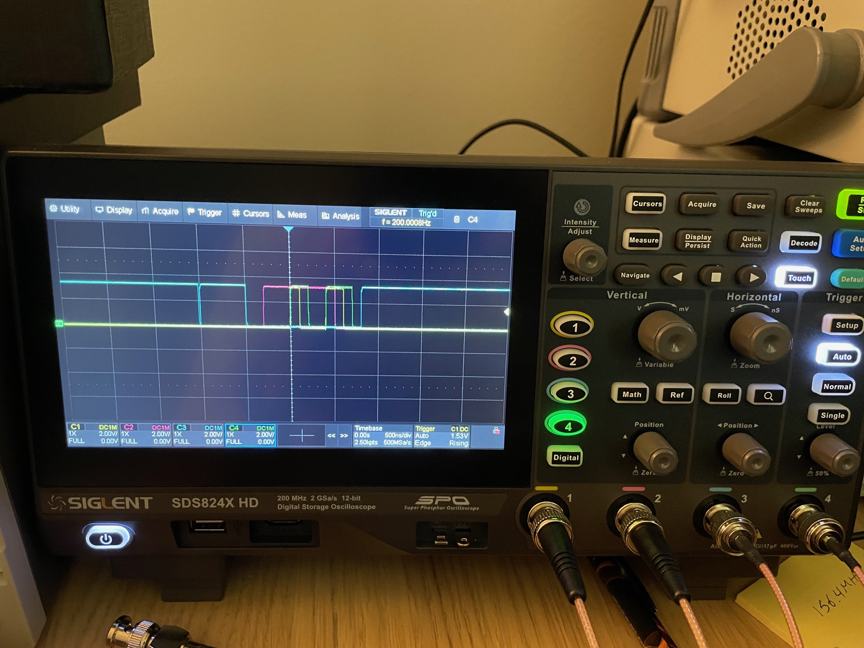
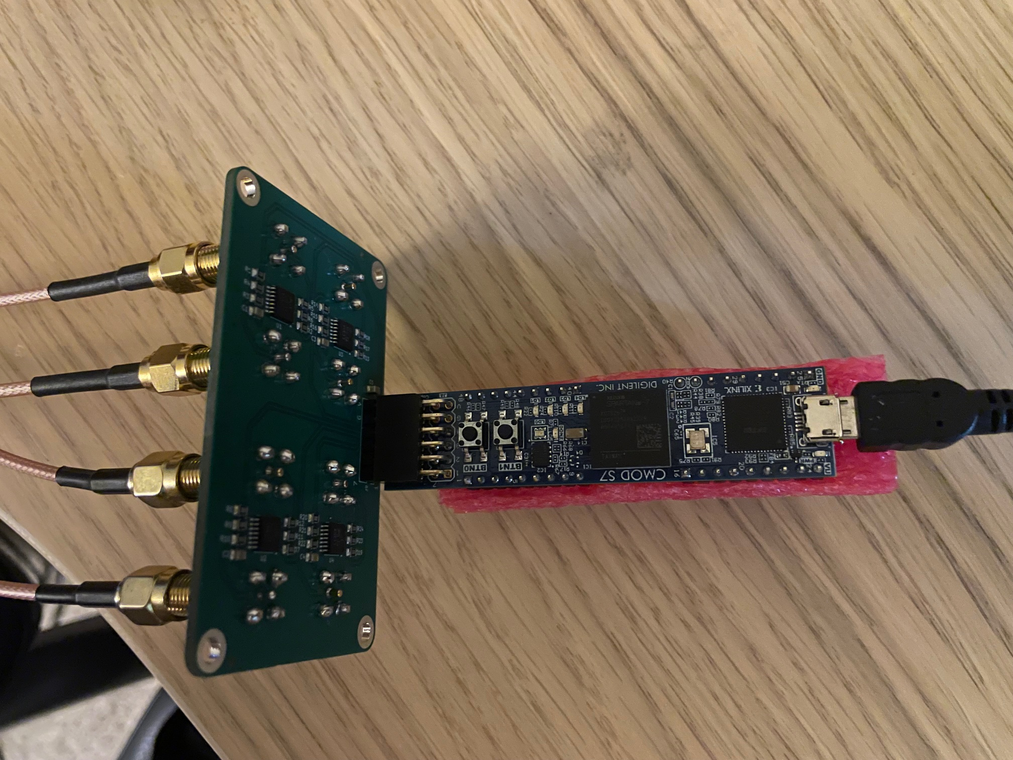
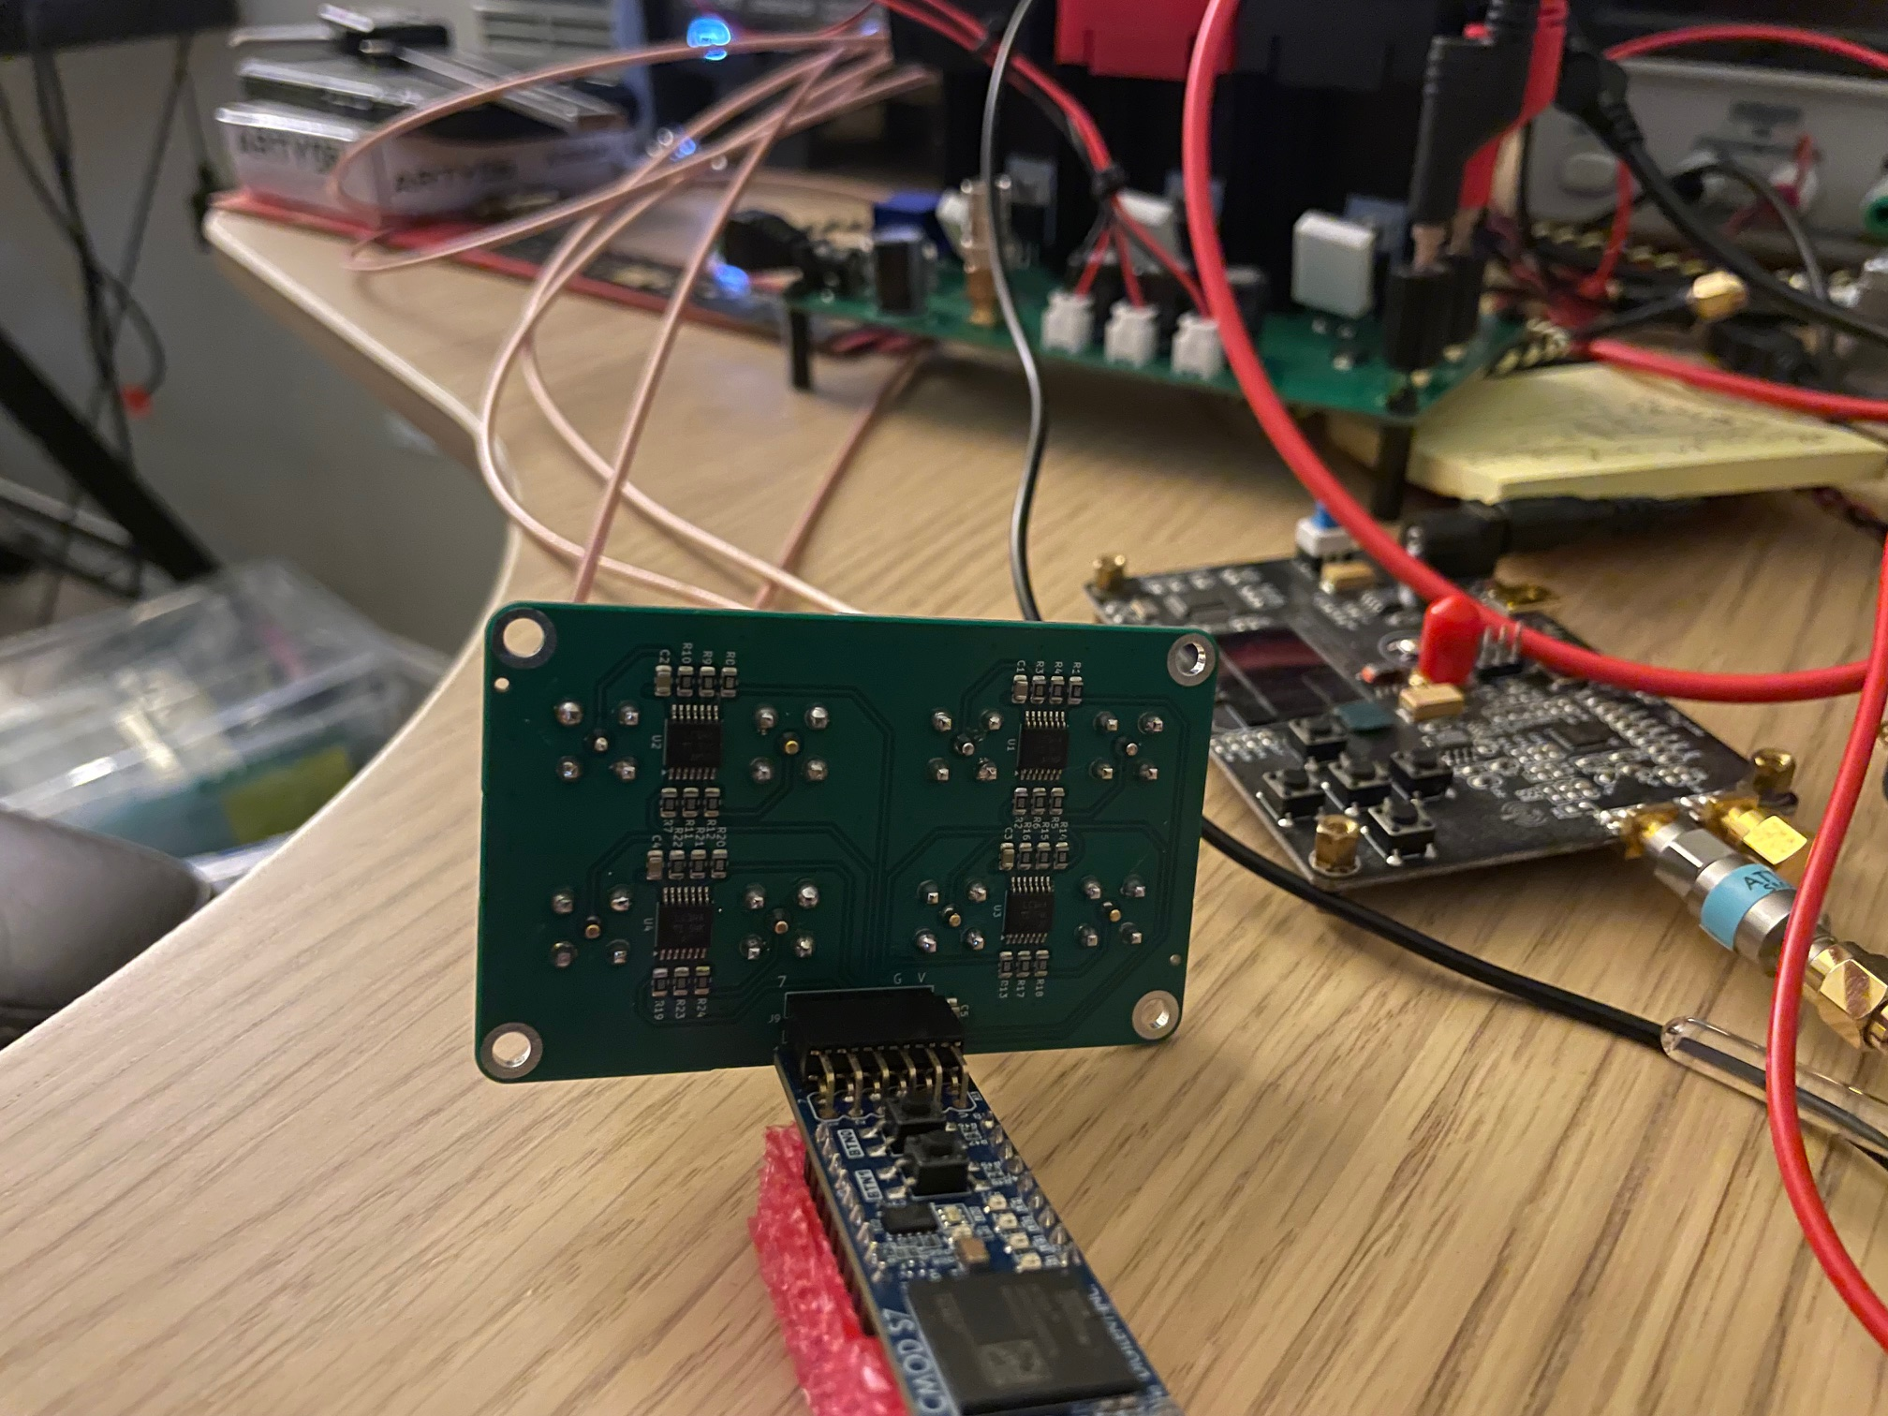
Hardware Photos

Slide 8
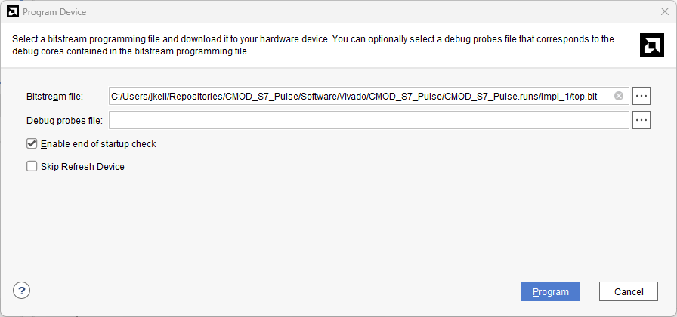
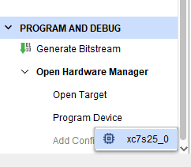
Programming Device (Development)

Slide 9
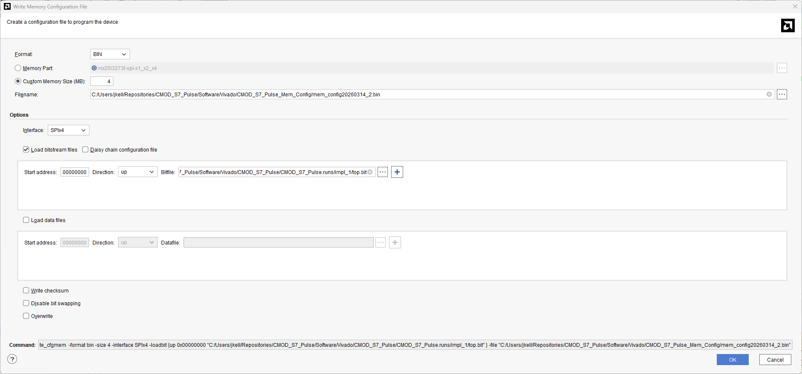
Creating Memory Config in Vivado
Tools -> Generate Memory Configuration File

Slide 10
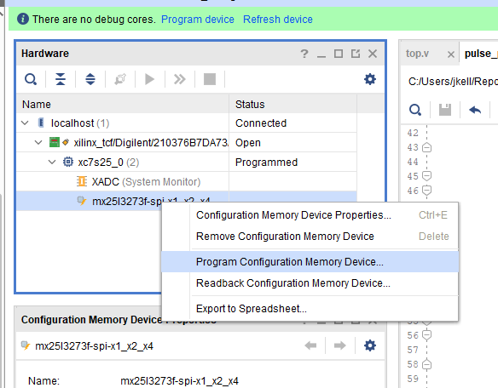
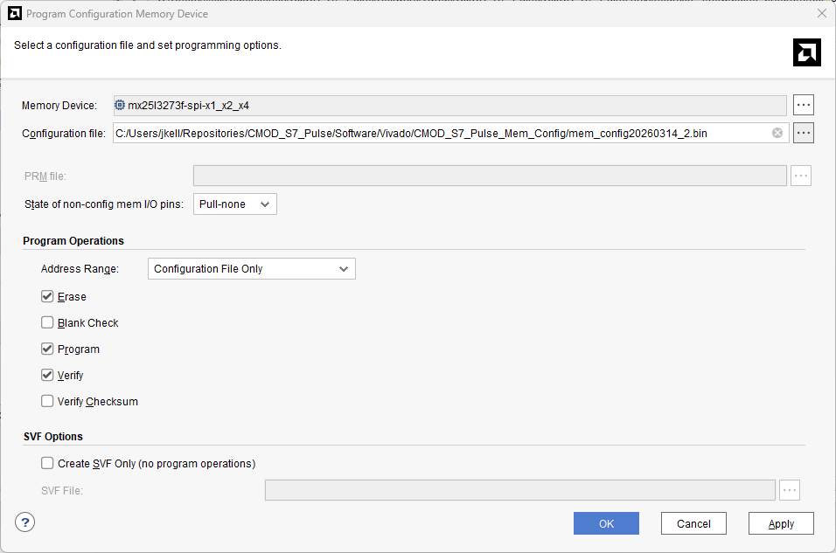
Writing Memory Configuration

Slide 11
Programming Words (v1)
Need at least 12-bit data for address in GOTO op-code
NOT IMPLEMENTED
command | addr | pulse pattern | DDS | data | op code | delay
4-bit | 12-bit | 8-bit | 8-bit | 12-bit | 4-bit | 32-bit
[79:76] | [75:64] | [63:56] | [55:48] | [47:36] | [35:32] | [31:0]

